Slide 1
Build React SPA apps with the Microsoft Graph

Slide 2

Building Microsoft Graph applications
Intro to the Microsoft Graph API
Getting started
SDKs & Code Samples
Resources

Slide 3
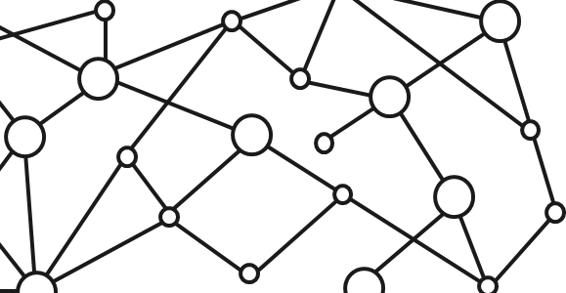
Microsoft 365 Platform
Extend Microsoft 365 experiences
web, device, and service apps
Build your experience
Documents
Pages
Conversations
Timeline
iOS/Android/Windows/Web
1
Microsoft Graph
Notes:
Our Office 365 developer vision focuses on the Users’ experience and their data. As a developer you can bring your applications into their user experience. With over 1.2+ billion users of Office Worldwide, this is a huge opportunity to provide a window into your applications. As well as being able to connect into their data and add intelligence to your applications. There are currently 850 million events created a month and a total of 470Pb+ of data stored in the service that can add value to for our Users’.

Slide 4
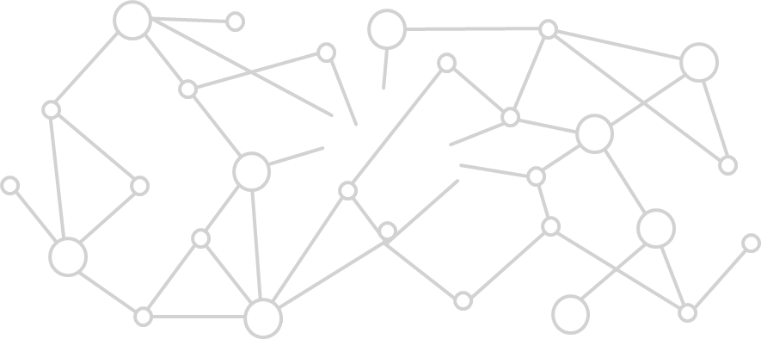


Microsoft Graph Gateway to your data in the Microsoft-cloud
https://graph.microsoft.com
Office 365
Windows 10
Enterprise Mobility + Security
Users, Groups, Organizations
Outlook
SharePoint
OneDrive
Teams
Planner
Excel
OneNote
Activities
Device Relay
Commands
Notifications
Azure AD
Intune
Identity Manager
Advanced Threat Analytics
Advanced Threat Protection
Mail, Calendar,
Contacts and Tasks
Sites and Lists
Drives and Files
Channels, Messages
Tasks and Plans
Spreadsheets
Notes, and more…
Identity Management
Access Control
Synchronization
Domains
Administrative Units
Applications and Devices
Advanced Threat Analytics
Advanced Threat Protection
Alerts
Policies
and more…

Slide 5
Microsoft Graph, gateway to Office 365
Single resource that proxies multiple Microsoft services
Allows for easy traversal of objects and relationships
Simplifies token acquisition and management
Eliminates the need to traditional discovery (using “me” and “myorganization”)

Slide 6
Office 365 direct API Endpoints
Direct API endpoints for all the Office 365 Services may also be invoked
Outlook, OneDrive, OneNote, etc.
Direct endpoints have new functionality before it is exposed via the Graph API
Examples:
Outlook web hooks
Time zone on calendar

Slide 7
Single authentication flow for Office 365
Sign users in using OpenID Connect
Azure AD and Office 365 services
Supports MFA and federated user sign-in
Device apps, web sites, SPAs, and service apps
Pin apps to Office 365 app launcher from My apps

Slide 8
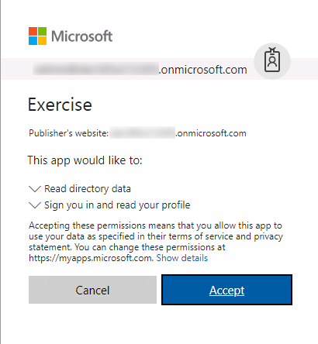
Common consent
Single auth flow for accessing all O365 services
Admin and end-user consent
Secure protocol
OpenID Connect and OAuth 2.0
No capturing user credentials
Fine-grained access scopes
Long-term access through refresh tokens

Slide 9
Authentication Options
Azure AD only
Separate auth flow supports Azure AD accounts only
Azure AD and Microsoft Accounts
Converged auth flow supports Azure AD accounts and Microsoft accounts (LiveID - hotmail.com, etc.)

Slide 10
Microsoft Account + Azure AD
Many apps want to sign users in from both Microsoft account and Azure AD
Single endpoint, OpenID Connect and OAuth 2.0
Single SDK
Single end user sign in experience
Single app registration experience
Works with Microsoft Graph
Single API endpoint, business and consumer data

Slide 11
Creating an React single page application configured with MSAL for authentication with Azure AD

Slide 12
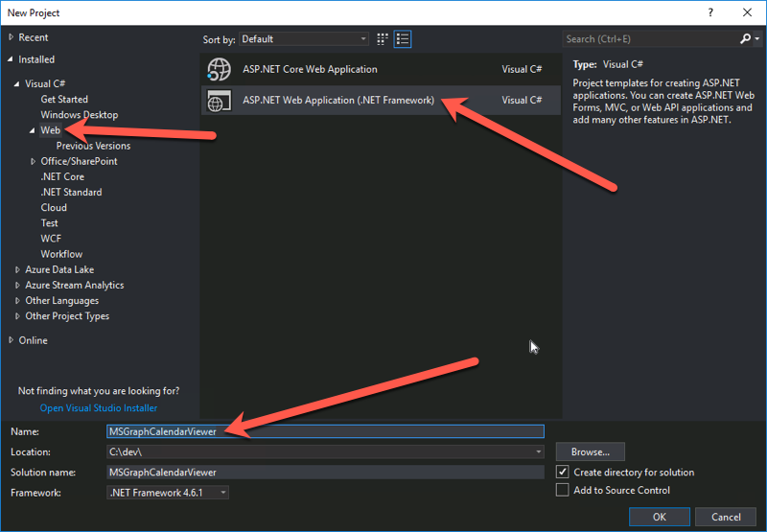
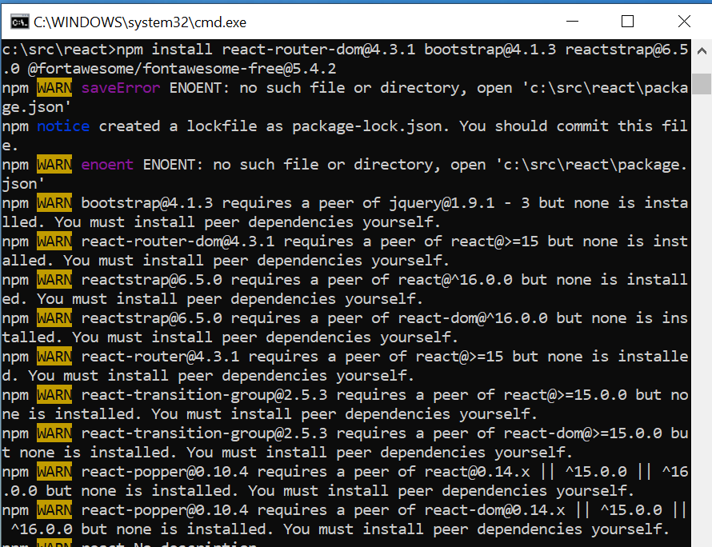
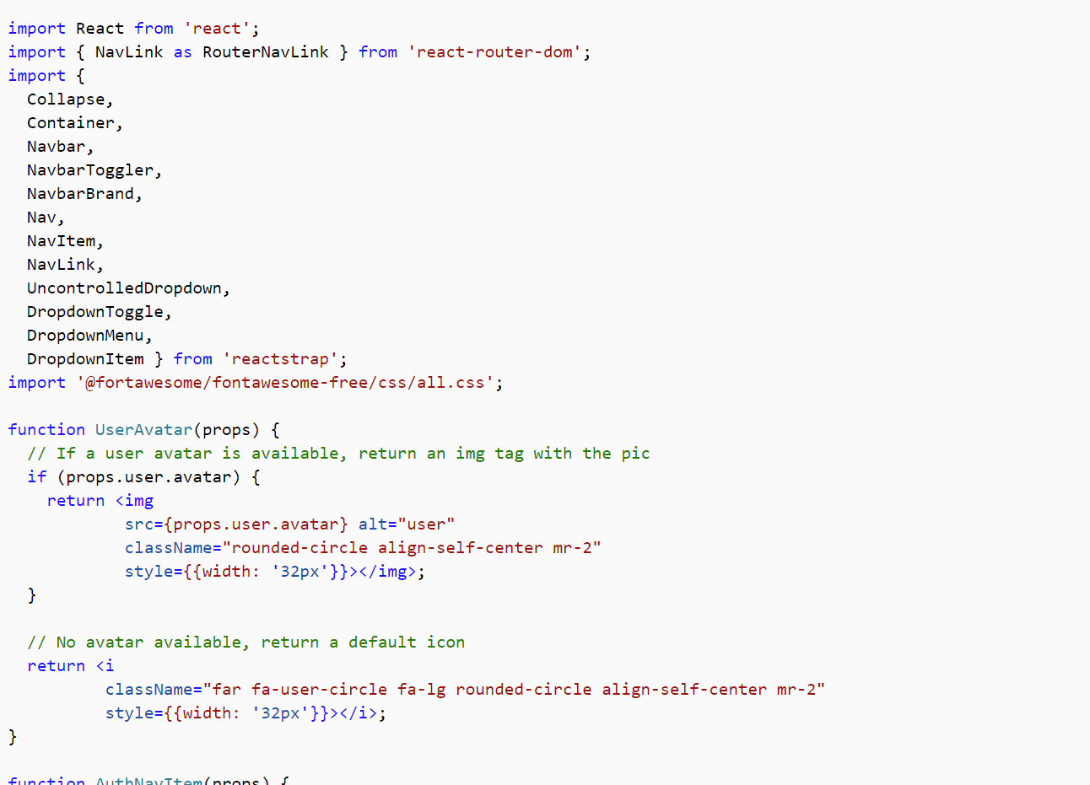
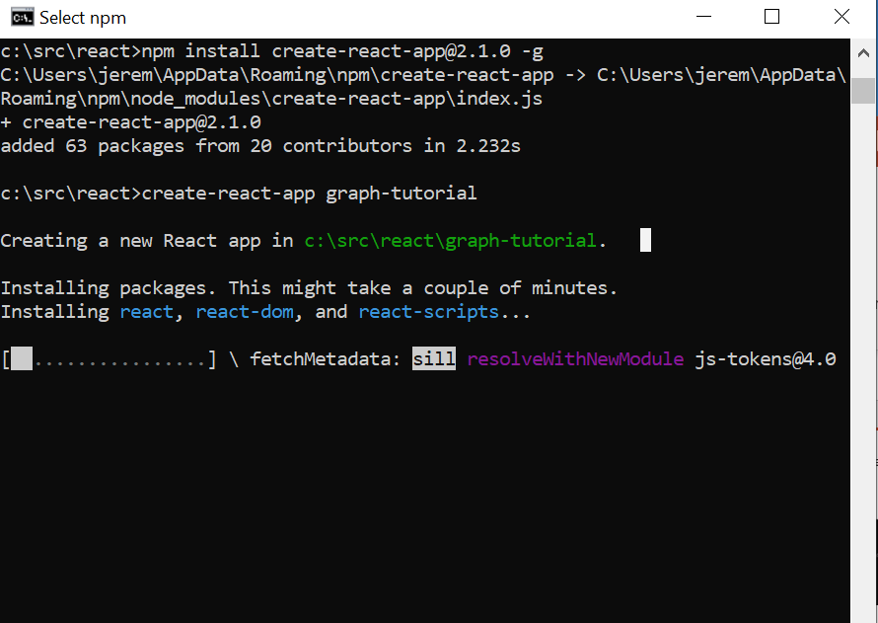
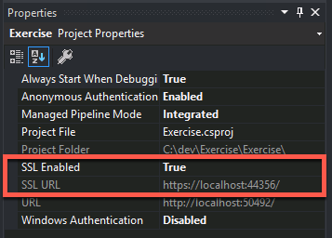
Create React single page application
Create the React SPA
Use create-react-app graph-tutorial
Install additional packages
Install some additional packages: react-router-dom, boostrap, reactstrap, fontawesome-free, moment, msal, microsoft-graph-client
Design the app
Create the stubbed UI view controllers for you’re the app

Slide 13
Demo

Slide 14
Thank you.

